Slide 1
The Common Cluster
(Arrival)
Friday April 20

Slide 2
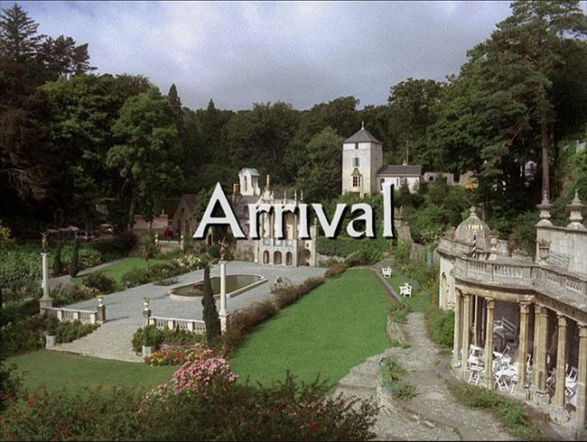
Arrival Day: April 20, 2018

Slide 3

We have come a long way
Installed an initial operating system from USB
Called the initial machine our server
Configured the server to be a Cobbler Server
Used PXEBOOT to net-install the second machine referred to as client
Configured the server to be a Puppet Server
Used Puppet Server to configure client machine
Installed autofs from command line on the server
Used Puppet to install autofs on the client
With autofs installed you can now NFS mount /nfs/htc180
Added an addition disk to the class server /nfs/htc-data
Added to autofs on both the server and the client
Installed HTCondor from the command line on the server
Installed HTCondor using Puppet on the client
Ran our first cluster computing job - Calculation of π using Monte Carlo Methods

Slide 4
Transitioning to One Room, One World, One Cluster
It is now time to transition from having 5 separate mini clusters in the room to having one cluster with 11 compute nodes.
This cluster with have a total of 44 cores.; up to 66 if we run on the server.
Some Future Features:
Distributed high performance file system (Hadoop)
NFS file system for long term storage.
NFS file system will be on the class server.
Hadoop file system will be distributed across all the machines.
Central managed accounts that are available on all machines

Slide 5
New Google Drive Subdirectory: Transition to single cluster
Transition Documentation:
00 Task List for Creating Cluster Room
Documents that are a work in progress:
Cluster Account Creation and Management
Ganglia - Network Utilization Monitoring
Nagios System Monitoring
Puppet - node.py, profile and role
Puppet Forge - Community Modules
Python tutorial
Setting up class server
Singularity Containers
Virtual Machines and Containers
Working with hiera data
Working with Puppet Templates
Documents are in different states of development.
More to come

Slide 6
Some Goals:
Keep the system usable during the transition
Want to start having tutorials?
Start offering a facility for faculty to do research?
Do you think you could offer a HTCondor tutorial to engineering on April 27?
Notice the lhe word above “YOU”!

Slide 7
Class 14 Agenda: Individualization
Date: April 19, 2018 Objective: Add a GUI to the Puppet Client Create individual accounts on all machines One combined cluster Compile and submit program to HTCondor
Submit 500 copies of program to HTCondor
Class 12 Slides: Class 12 - Transitioning to One Cluster
In-class documentation: Class 14 - Puppet Configuration for GUI Class 14 - Combining Resources to Make One Cluster

Slide 9
